Slide 1

Fuzzing RDPEGFX with what the fuzz
Colas Le Guernic, Jérémy Rubert, and Tomme of Normandy
October 15 th, 2022

Slide 2

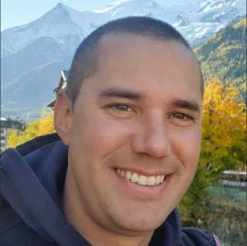
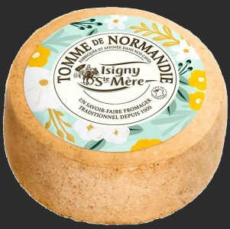


Who are we?
Colas Le Guernic
Jérémy Rubert
Tomme
of Normandy
team members
( part of
)
| reverse | vulnerability research | red team | hiring | 2

Slide 3


Valentino's 2021 internship
Jérémy Rubert
Tomme
Valentino Ricotta, 2021 intern
and soon a full t ime Thalium member
3

Slide 4
Valentino's 2021 internship
Fuzz Remote Desktop Protocol clients
WinAFL + network-level approach for the harness build over a BH Europe 2019 talk by Park et al.:
Fuzzing and Exploiting Virtual Channels in Microsoft RDP for Fun and Profit
Results:
4 CVEs (2 Microsoft, 2 FreeRDP)
thalium.re blog posts and SSTIC 2022 talk

Slide 5
Valentino's 2021 internship
Several limitations:
some channels could not be fuzzed
unknown protocol state (hard to reproduce) availability (restart on malformed message)
@0vercl0k had just released what the fuzz (wtf): a promising snapshot fuzzer
we had a few weeks off
Let's try to fuzz MS RDP client with wtf !

Slide 6
Outline
RDP and the EGFX channel
what the fuzz snapshot fuzzer Our fuzzing campaign
basic harness / snapshot
modified harness / coverage
crash / analysis / CVE-2022-30221
Detailed blog post on thalium.re

Slide 7
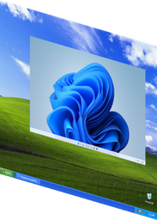



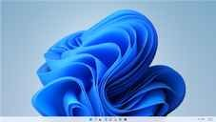
Microsoft Remote Desktop Protocol
mouse / keyboard
audio / graphics
clipboard/ printer/ smartcard/...
Documented through Microsoft Open Spec. program

Slide 8
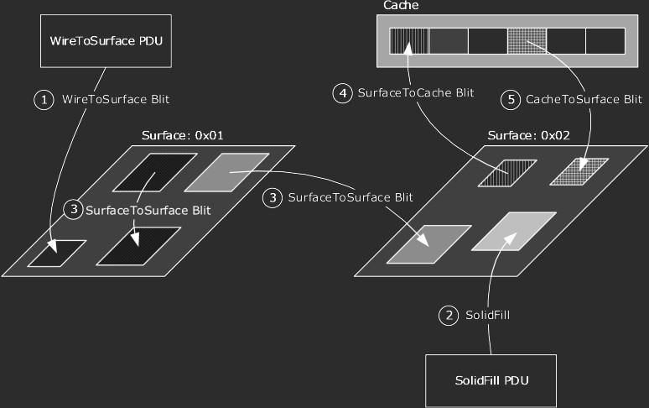
RDPEGFX: Graphics Pipeline Extension
Efficiently encode and transmit graphics display data from the server to the client
~asynchronous protocol 1 of many virt. channels
~20 commands (PDU) surface/cache/blit/...
multiple PDUs per msg
source:
docs.microsoft.com/en-us/openspecs/windows_protocols/ms-rdpegfx/
8

Slide 9
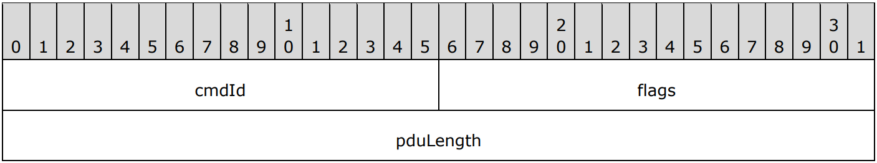
RDPEGFX: PDUs
Common Header:
Different body for each
cmdId

Slide 10
WhatTheFuzz
Snapshot fuzzer by @0vercl0k available at https://github.com/0vercl0k/wtf
snapshot --> harness --> fuzz!!!

Slide 11
wtf
snapshot
kernel debug, break on data processing, dump no more disk / IO
harness
breakpoint based
patch memory/registers to inject fuzz samples fuzz
run: emulator or hypervisor backend
restore cpu / dirty pages
repeat

Slide 12
Backends
Bochscpu
full emulation
KVM/Hyper-V
virtualization
one-time breakpoints for coverage
fast
collect all executed
rip
slow but powerful
can log tenet traces

Slide 13

bp on a memory dump
KVM/Hyper-V need breakpoints to register coverage
Virtual Addresses of basic blocks
Hardware Virtual Address Translation (VAT)
CR3
... Page Table Entry (PTE)
PTE.Valid == 1
Physical Addr
--> done by wtf

Slide 14



bp on a memory dump
PTE.Valid == 0
Many cases
not implemented in wtf
needed to set BP and can not handle cases accessing disk
Implemented in wtf PR#136
Or read documentation and use lockmem But who reads docs anyway?

Slide 15
Fuzzing campaigns
First campaign
Tweaking the Harness Tweaking the Coverage Crashes

Slide 16
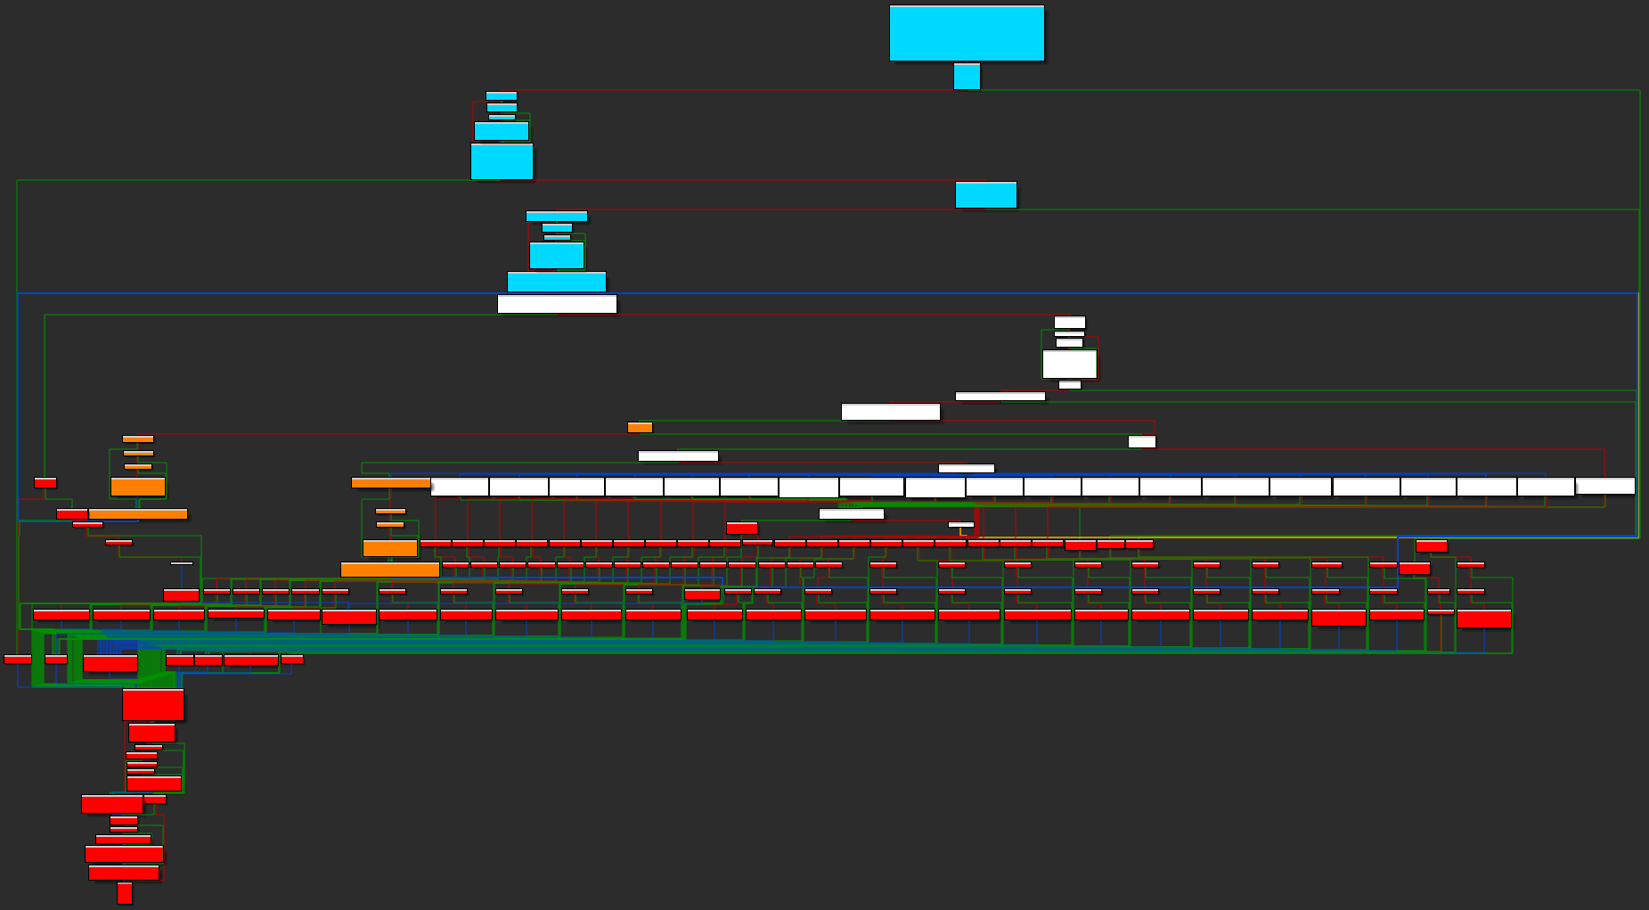
Harnessing RDPEGFX
mstscax.dll!
RdpGfxProtocolClientDecoder::Decode

Slide 17
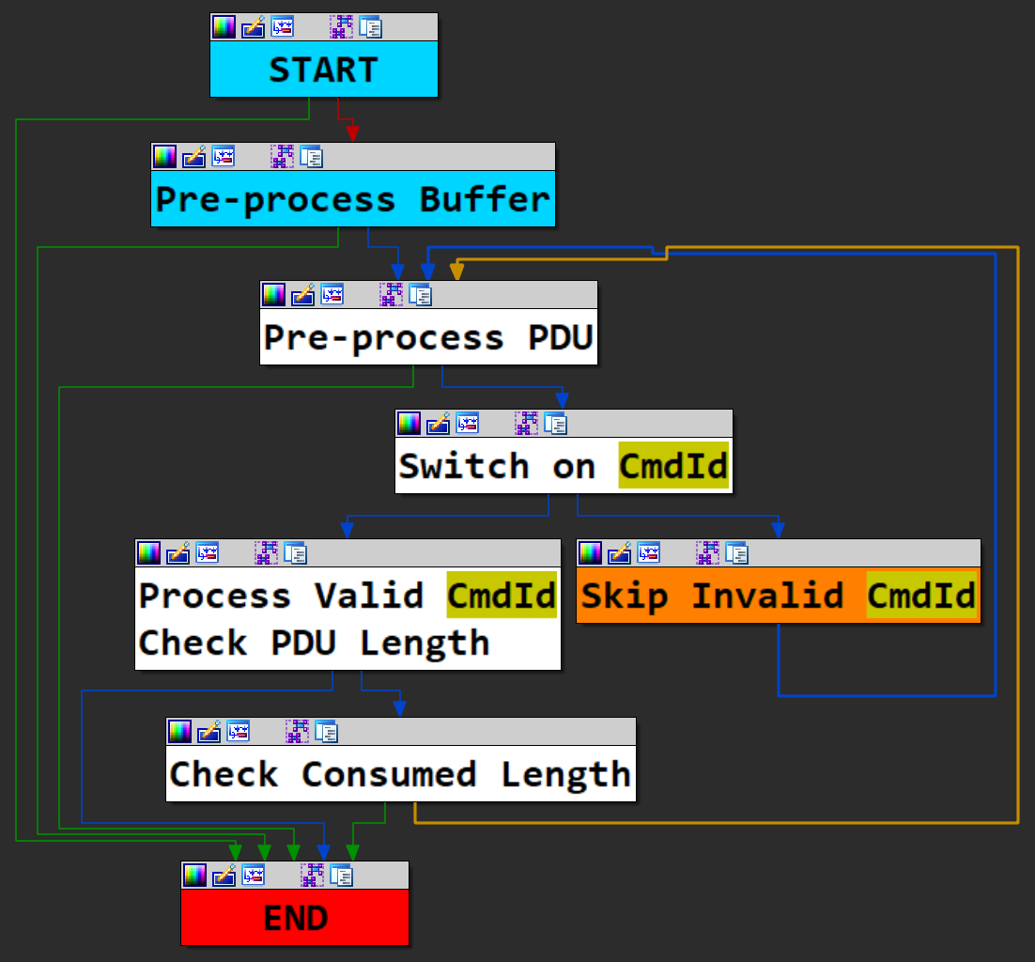

Harnessing RDPEGFX
1 buffer
1 PDU
many PDUs 1 of 20 cmds
dispatch to 20 handlers
Hook before PDU loop capture corpus
dump snapshot inject sample

Slide 18
First fuzzing campaign
Capture 989 messages from live RDP sessions 90% smaller than 22KB
Generate dump
Generate correct dump, then a better one...
Deactivate ETW Hook I/Os
performance counters, logs...
Make sure crash detection works

Slide 19
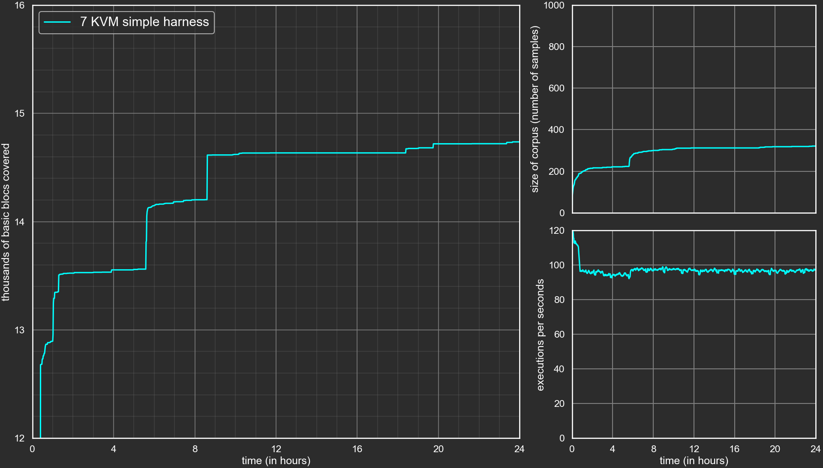

Slide 20
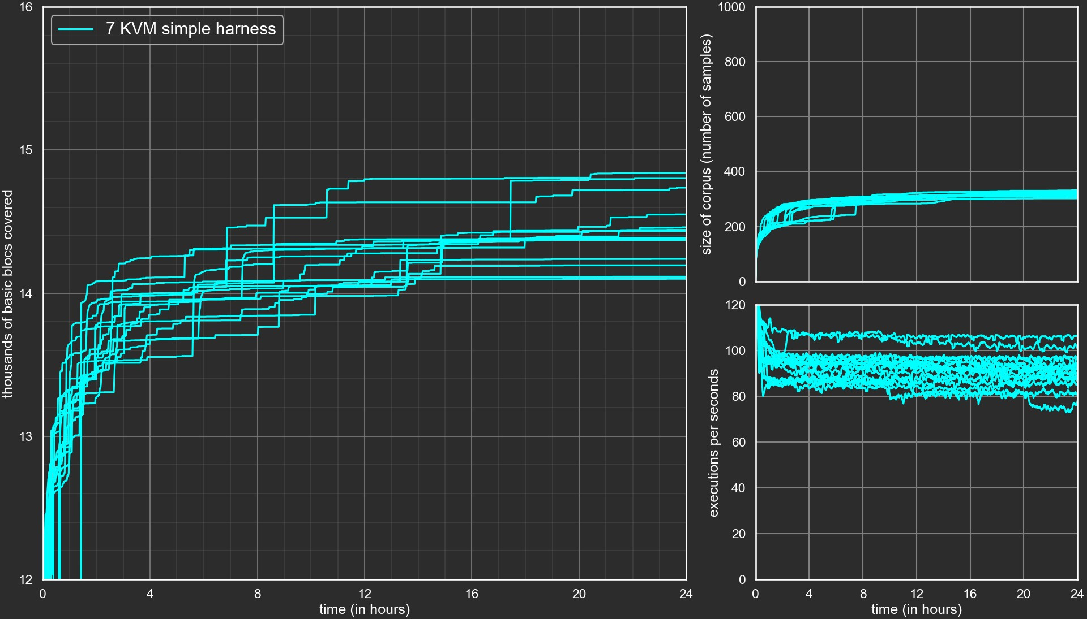

Slide 21
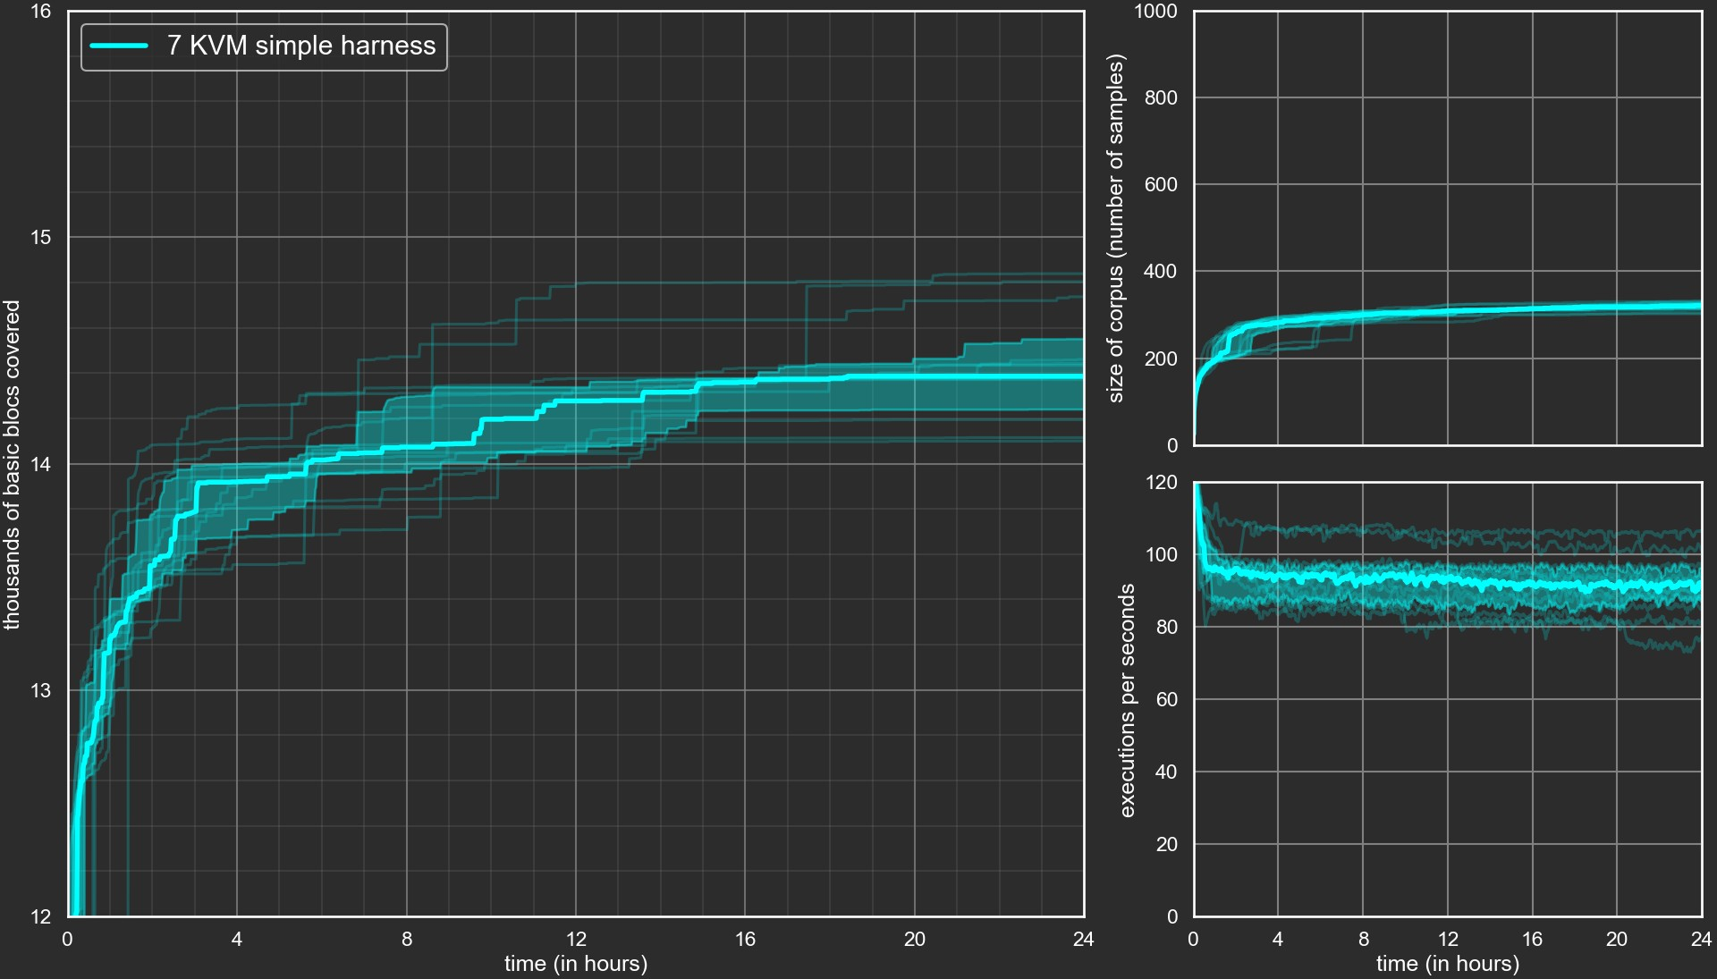

Slide 22
Improving campaigns and Evaluation
Main tweaks
better harness
on the fly fixes richer coverage
context sensitive edge dirty
Other Tweaks
premature exit
exotic coverages
imul
overflow
t iming
corpus tweaks
. . .
More details in our blog: thalium.re

Slide 23
Tweaking the Harness

Slide 24
Tweaking the Harness
On the fly modification of the sample
supply valid
CmdId
supply valid
Patch target
length
Skip
length
check

Slide 25
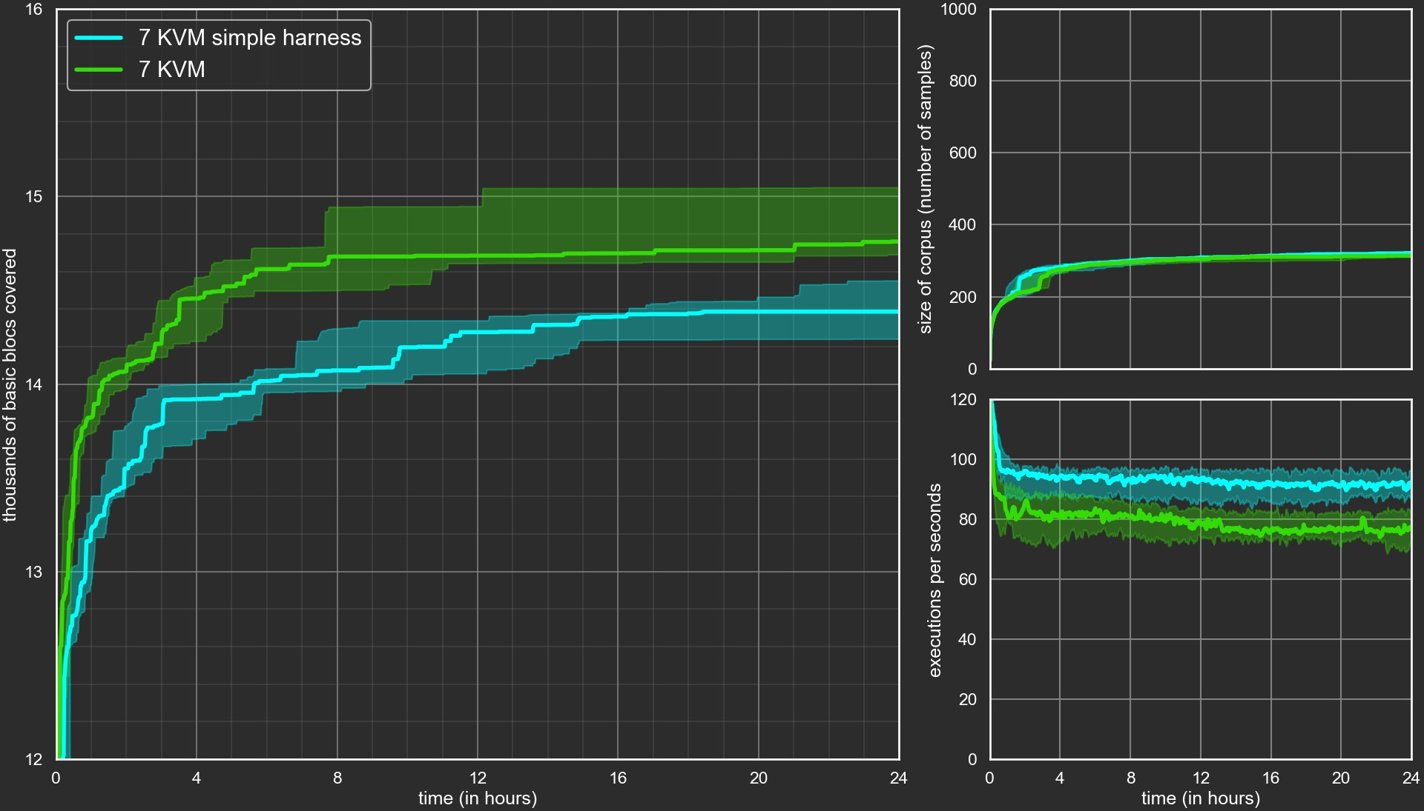

Slide 26
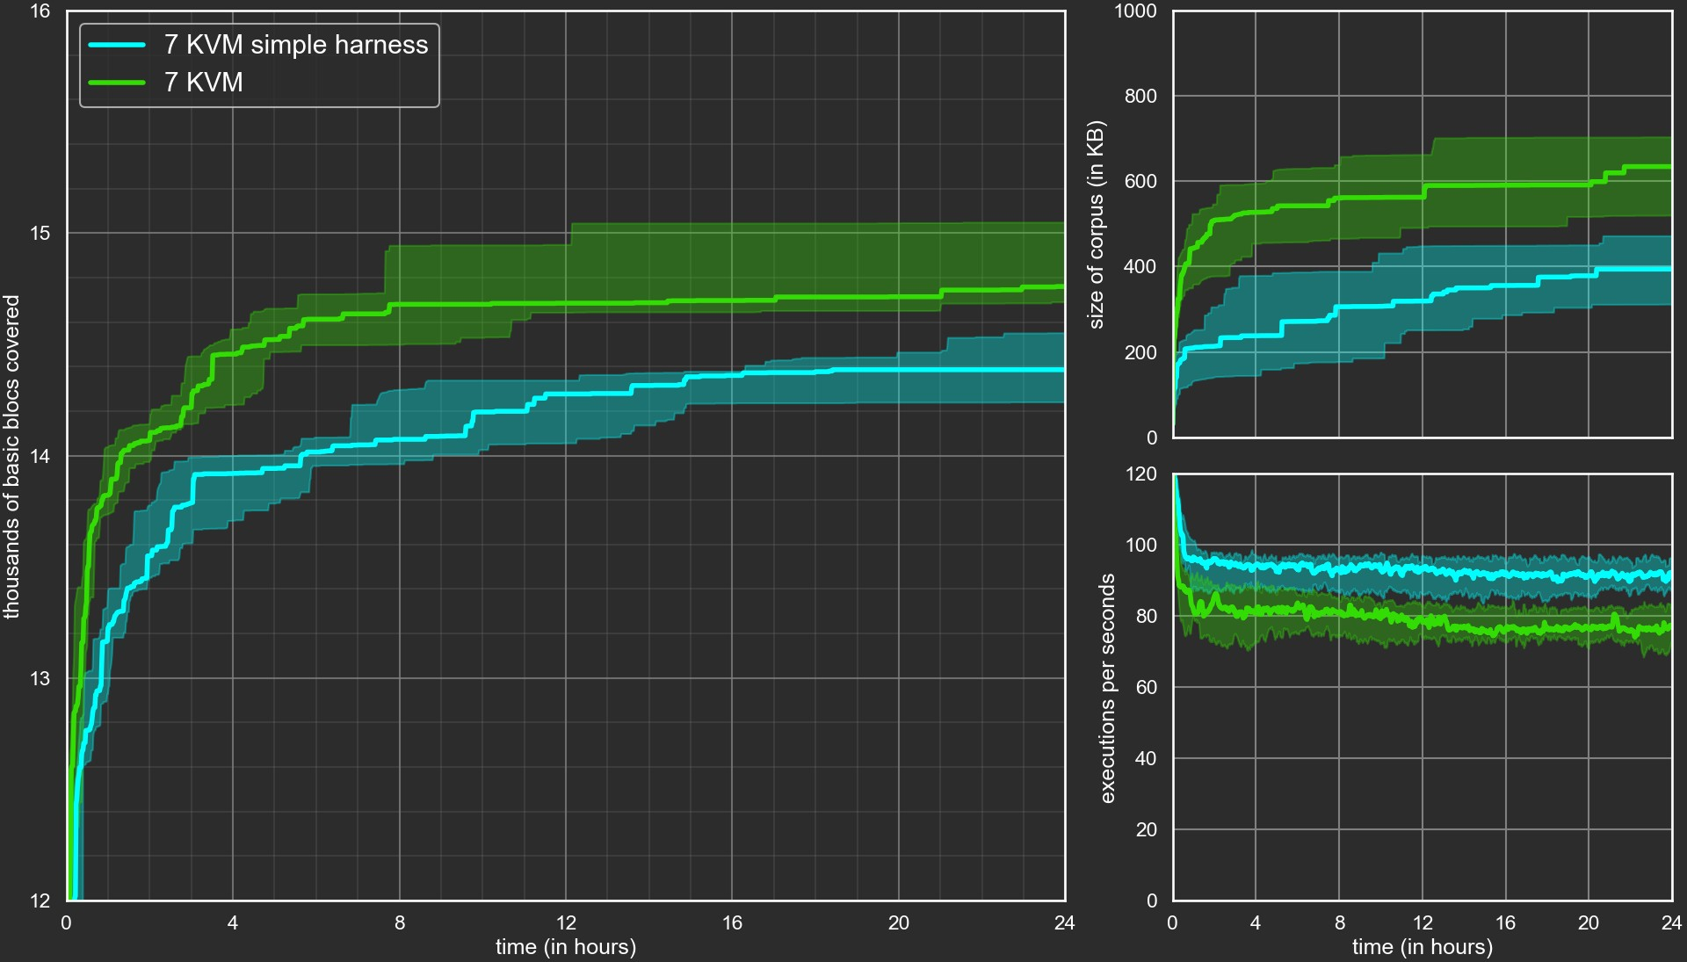

Slide 27
Tweaking the Coverage

Slide 28
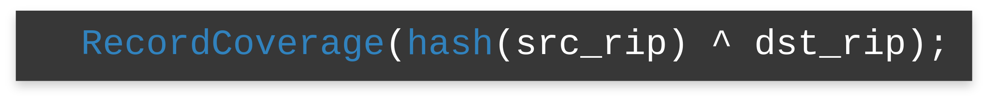
Edge Coverage
With Bochscpu, as simple as registering a callback:
The callback is called each t ime, when currently executed instruction is a conditional near branch and i t is taken.
calling:
similarly for
bx_instr_cnear_branch_not_taken
and
bx_instr_ucnear_branch
, implemented in PR#137

Slide 29
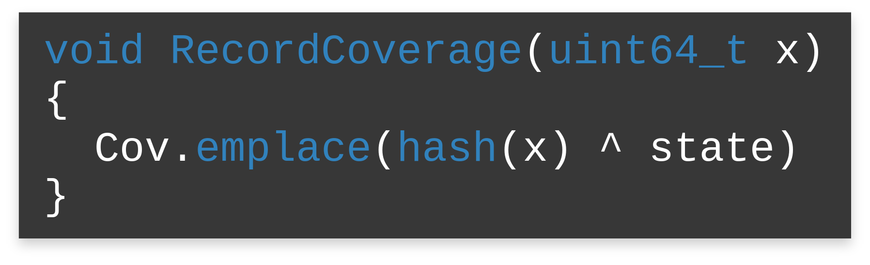
Context Sensitive Coverage
new public attribute:
Backend->state
Backend->state = CmdId

Slide 30
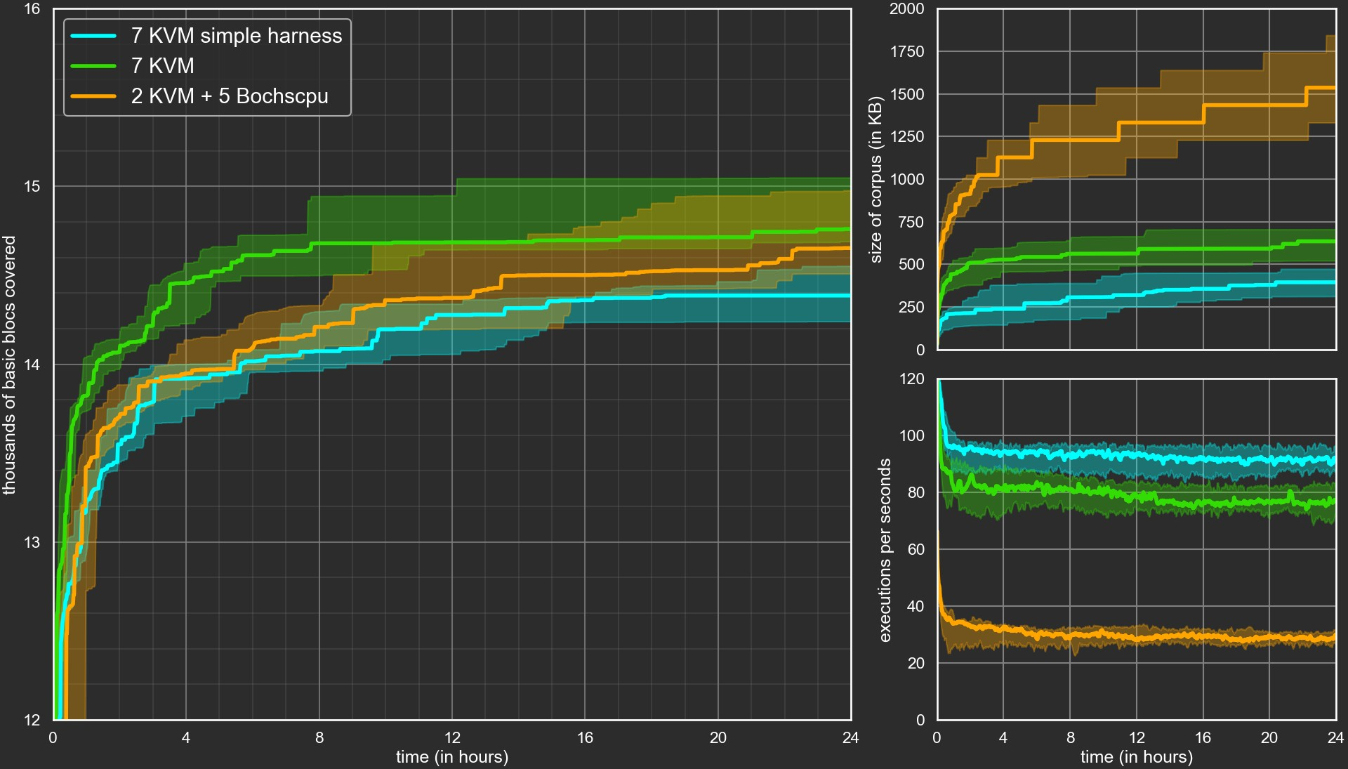

Slide 31
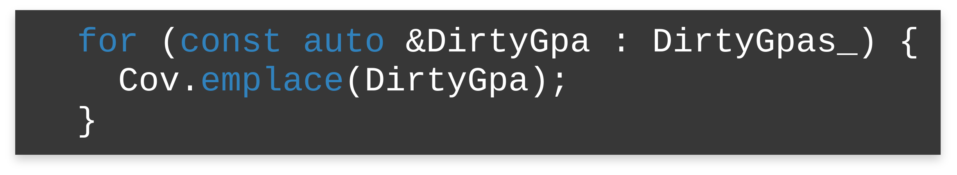
What about other Backends?
Basic blocks coverage with temporary breakpoints
Not easily extensible to edge coverage
What other behavioral information can we use?
dirty pages are already available for free
side effect: favor big allocations

Slide 32
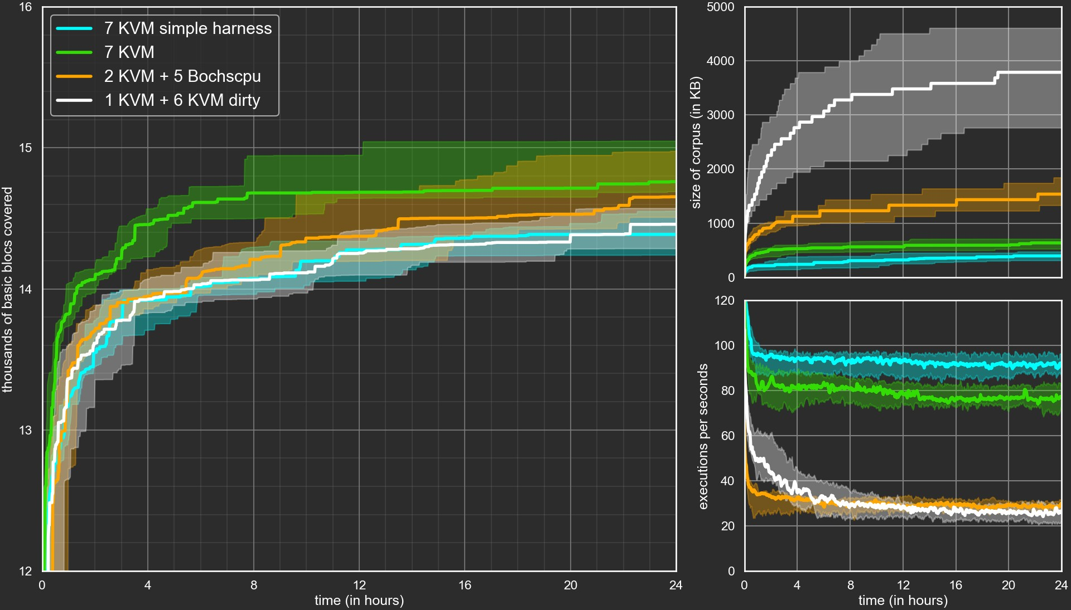

Slide 33
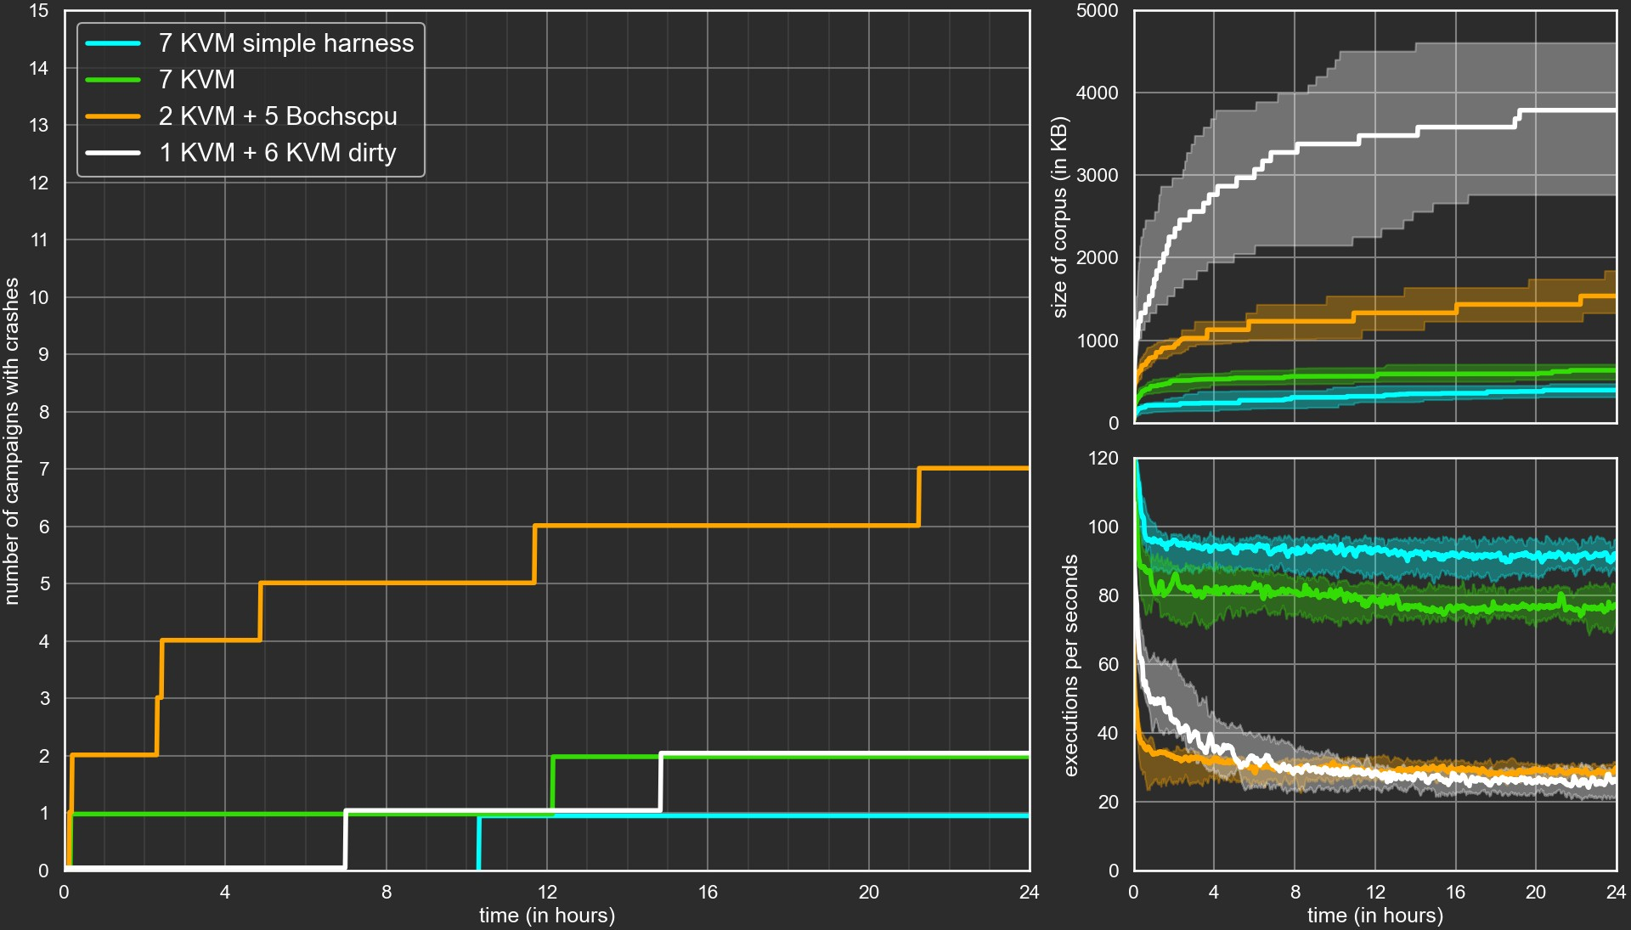

Slide 34
Crashes Encountered
A dozen of crashes! all spurious
either linked to an erroneous dump our aggressively optimized harness
or our wtf modifications
one seemingly spurious crash harder to analyse
crash-ACCESS_VIOLATION_WRITE-0x7df491561122

Slide 35

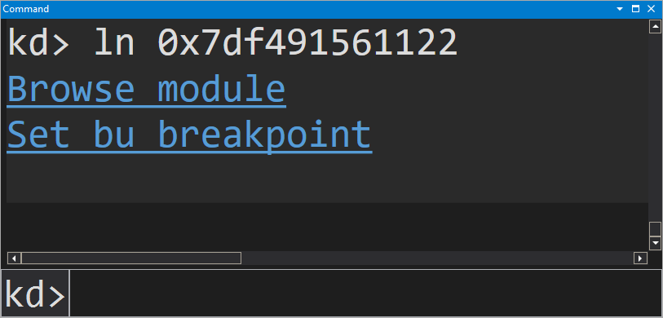


Crash analysis
crash-ACCESS_VIOLATION_WRITE-0x7df491561122
What is at 0 x 7 df 491561122 ?
Reproduce?
Bochs and Kvm Real system
Trace
Dozens of GigaBytes Symbolizer hangs
VSCode hangs
nothing in the dump ?!?

Slide 36
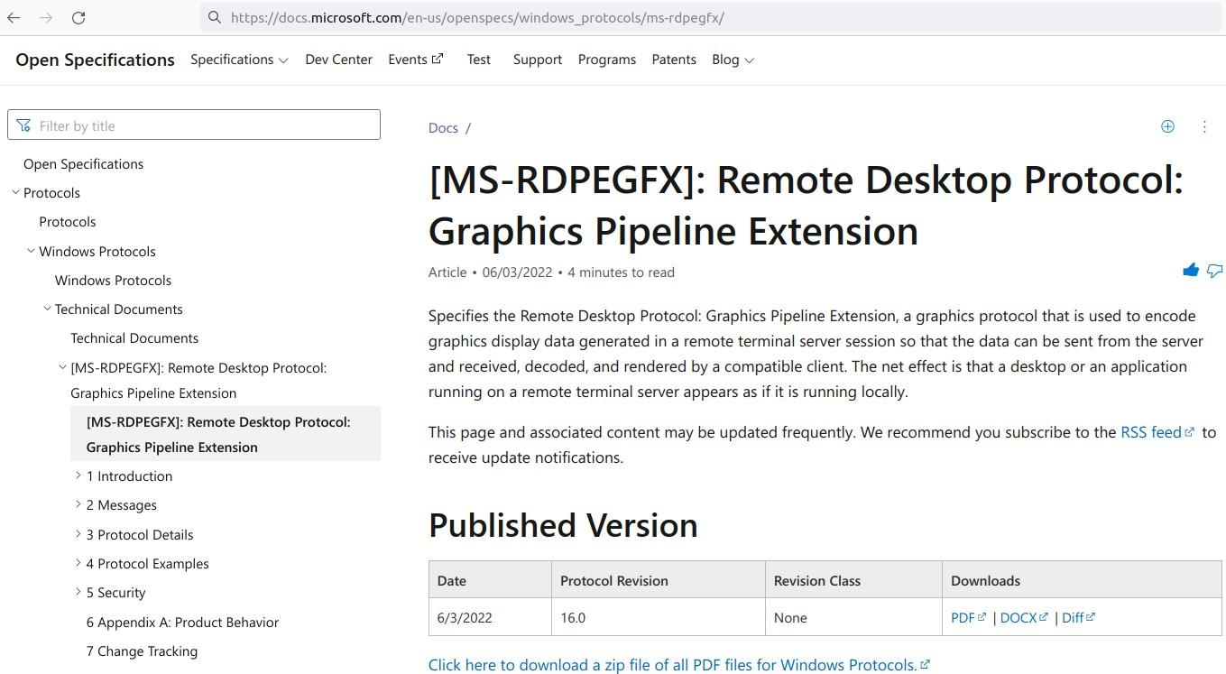
MS-RDPEGFX Open Spec.

Slide 37
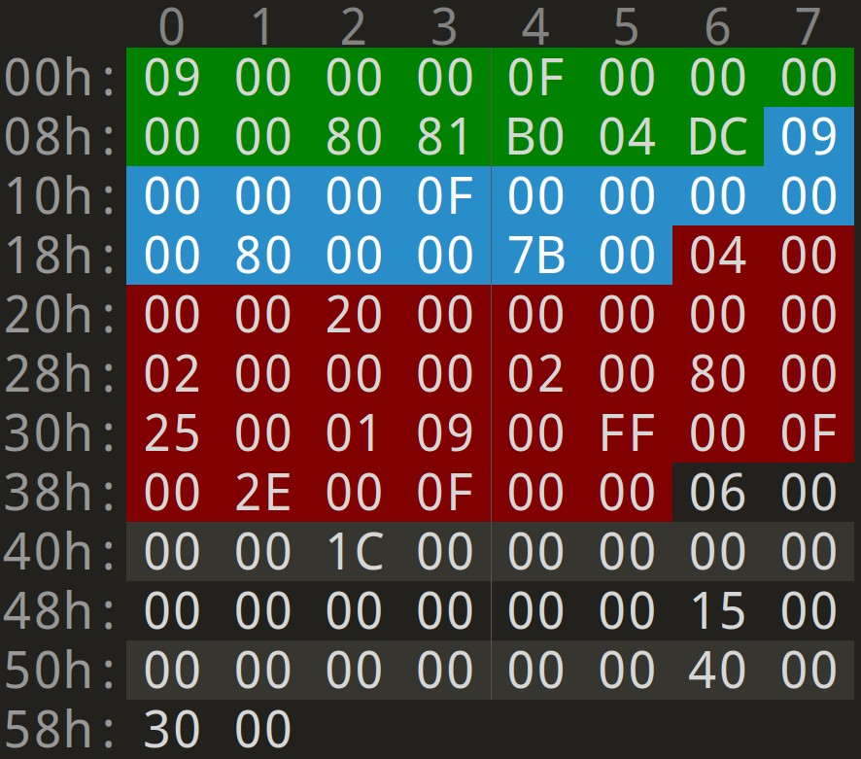




Crash Witness
CREATE_SURFACE
CREATE_SURFACE
SOLIDFILL
SURFACE_TO_CACHE

Slide 38
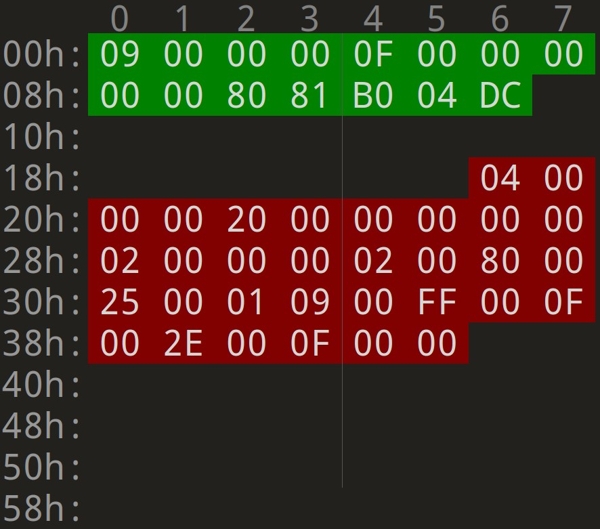
Minimal Crash Witness
CREATE_SURFACE
surfaceId
surface dimensions
SOLIDFILL
surfaceId
fill color
areas to fill

Slide 39
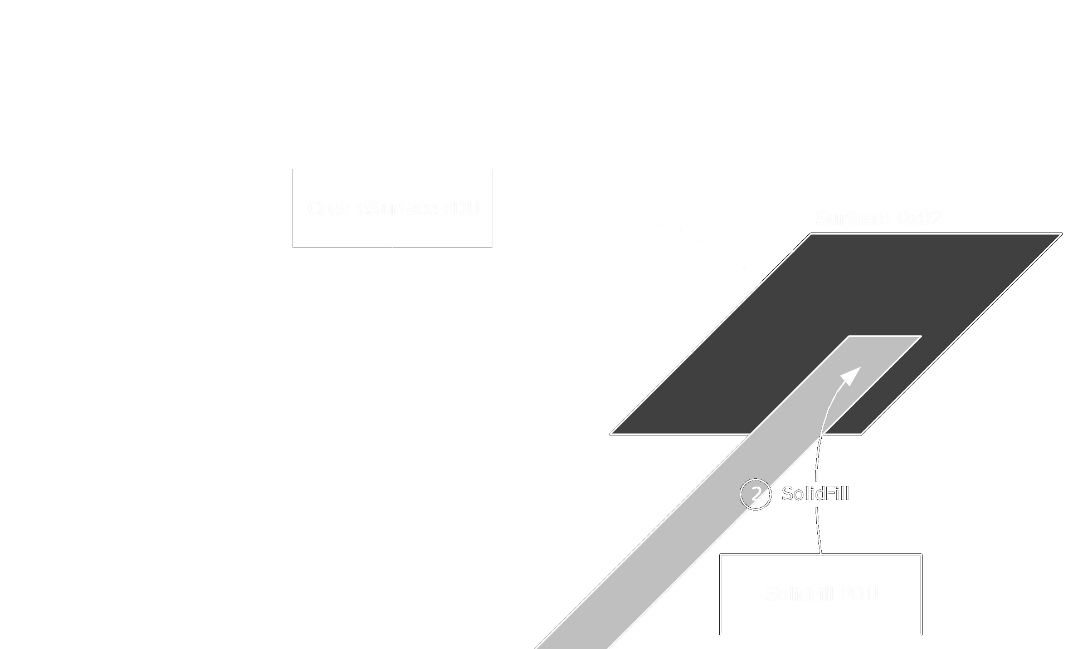
MS-RDPEGFX Open Spec.

Slide 40
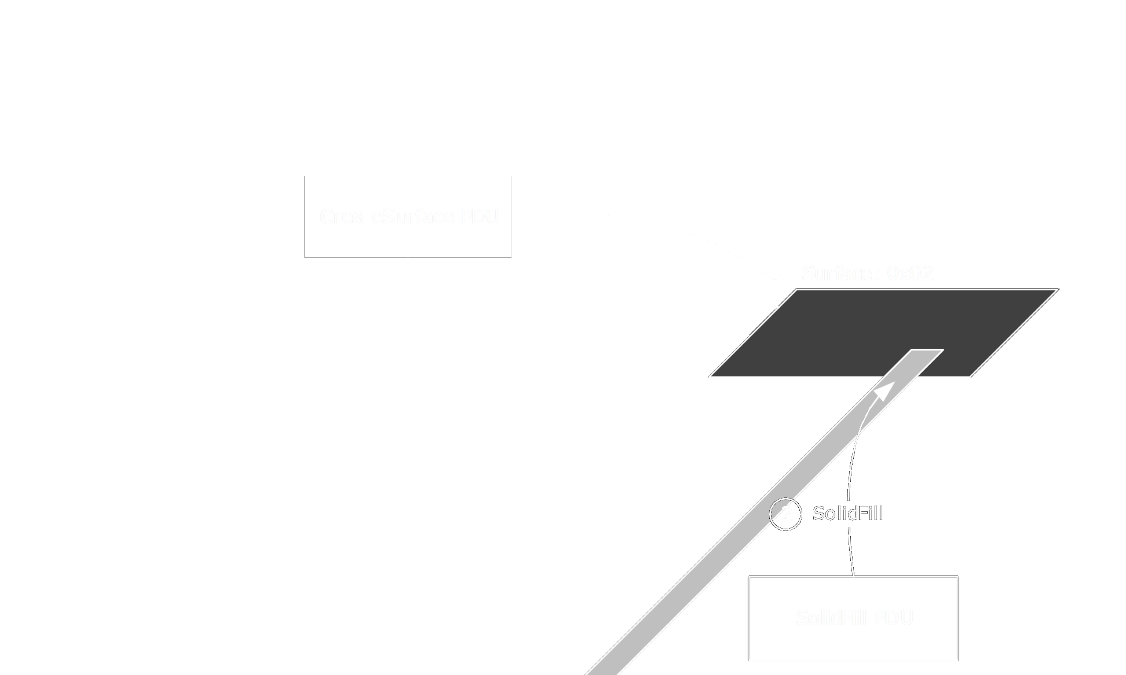
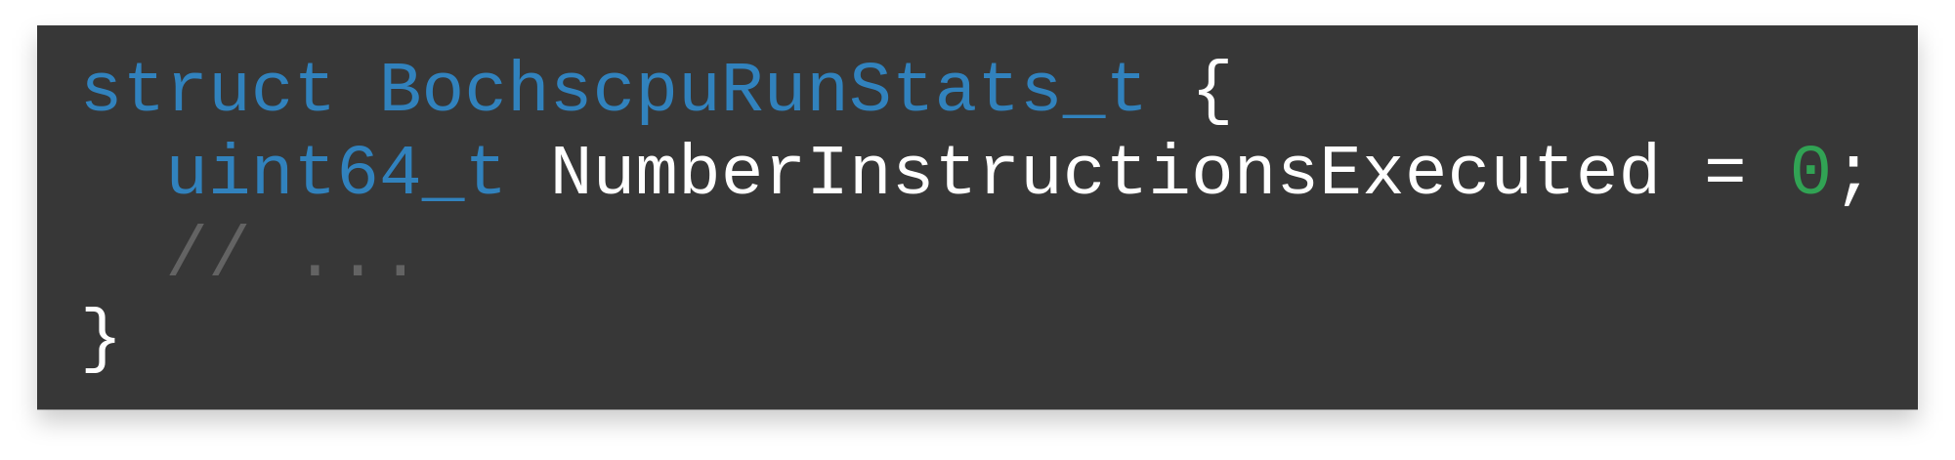
Crash Trace Minimization
Fuzz:
Optimize for short execution
( Actually... just hand made dichotomic search)
4 0

Slide 41




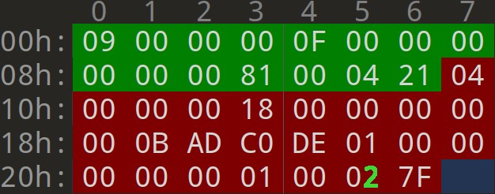
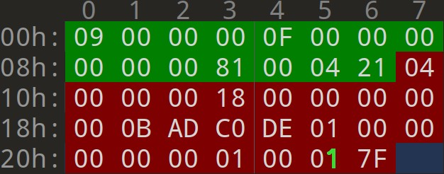
Crash Trace Minimization
Crash 218MB trace
No crash
CREATE_SURFACE_PDU
CREATE_SURFACE_PDU
Width: 0 x 8100 Height: 0 x 400
Width: 0 x 8100 Height: 0 x 400
SOLIDFILL_PDU
SOLIDFILL_PDU
Top Left: ( 0 , 0 )
Bottom Right: ( 1 , 0 x 7 F 02 )
Top Left: ( 0 , 0 )
Bottom Right: ( 1 , 0 x 7 F 01 )
4 1

Slide 42
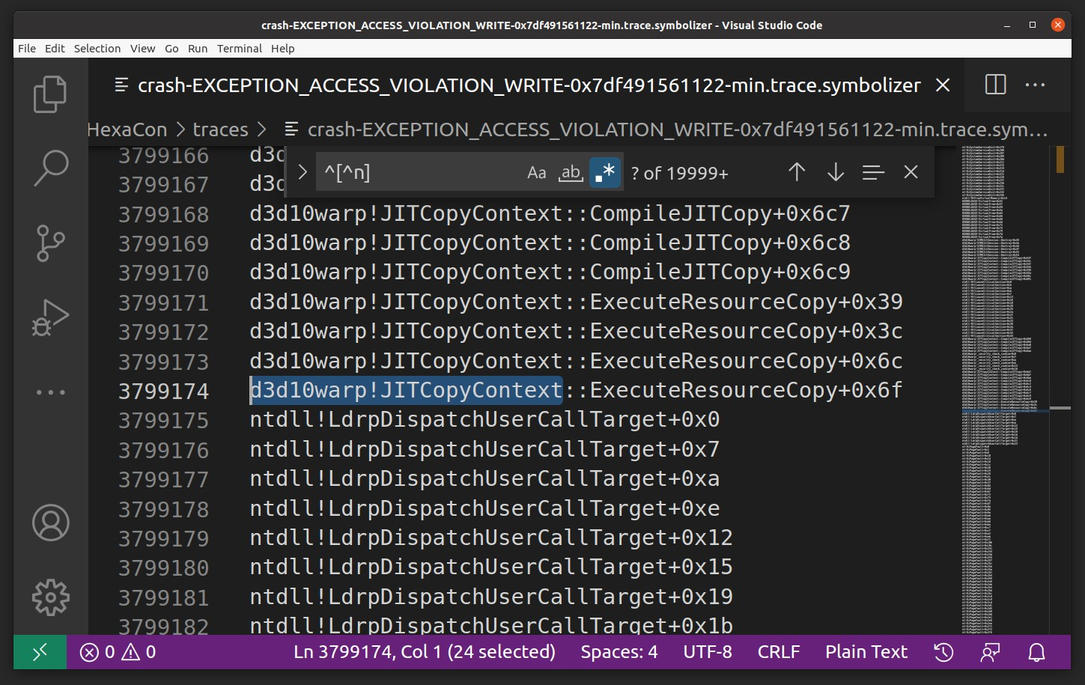

Slide 43

d3d10warp.dll
Windows Advanced Rasterization Platform
a high speed, fully conformant software rasterizer
[...] installed on Windows 7 [and up]
used when HW acc is undesirable or unavailable
Repro. on real system with generic VGA driver

Slide 44
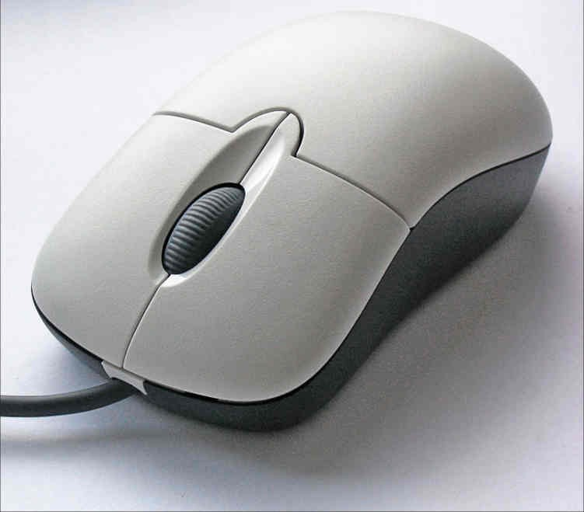
Root Cause Identification
by Differential Trace Analysis
Fancy way of saying that we compared the crash
and no-crash traces...
CC-BY-SA-2.5
commons.wikimedia.org/wiki/File:3-Tasten-Maus_Microsoft.jpg
4 4

Slide 45
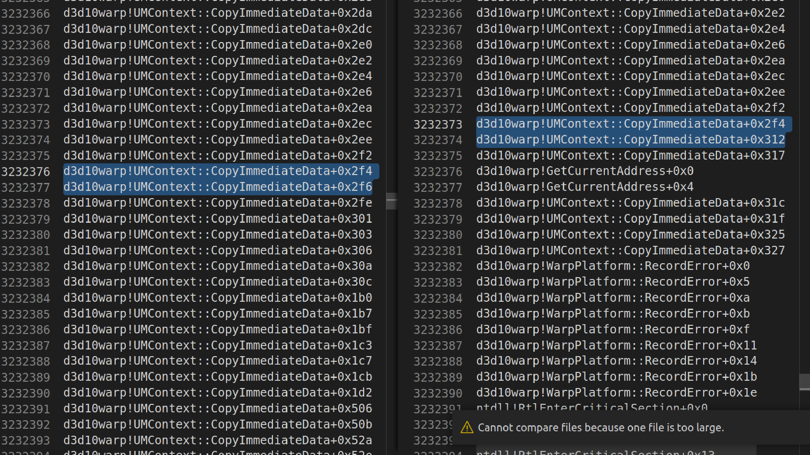

Slide 46
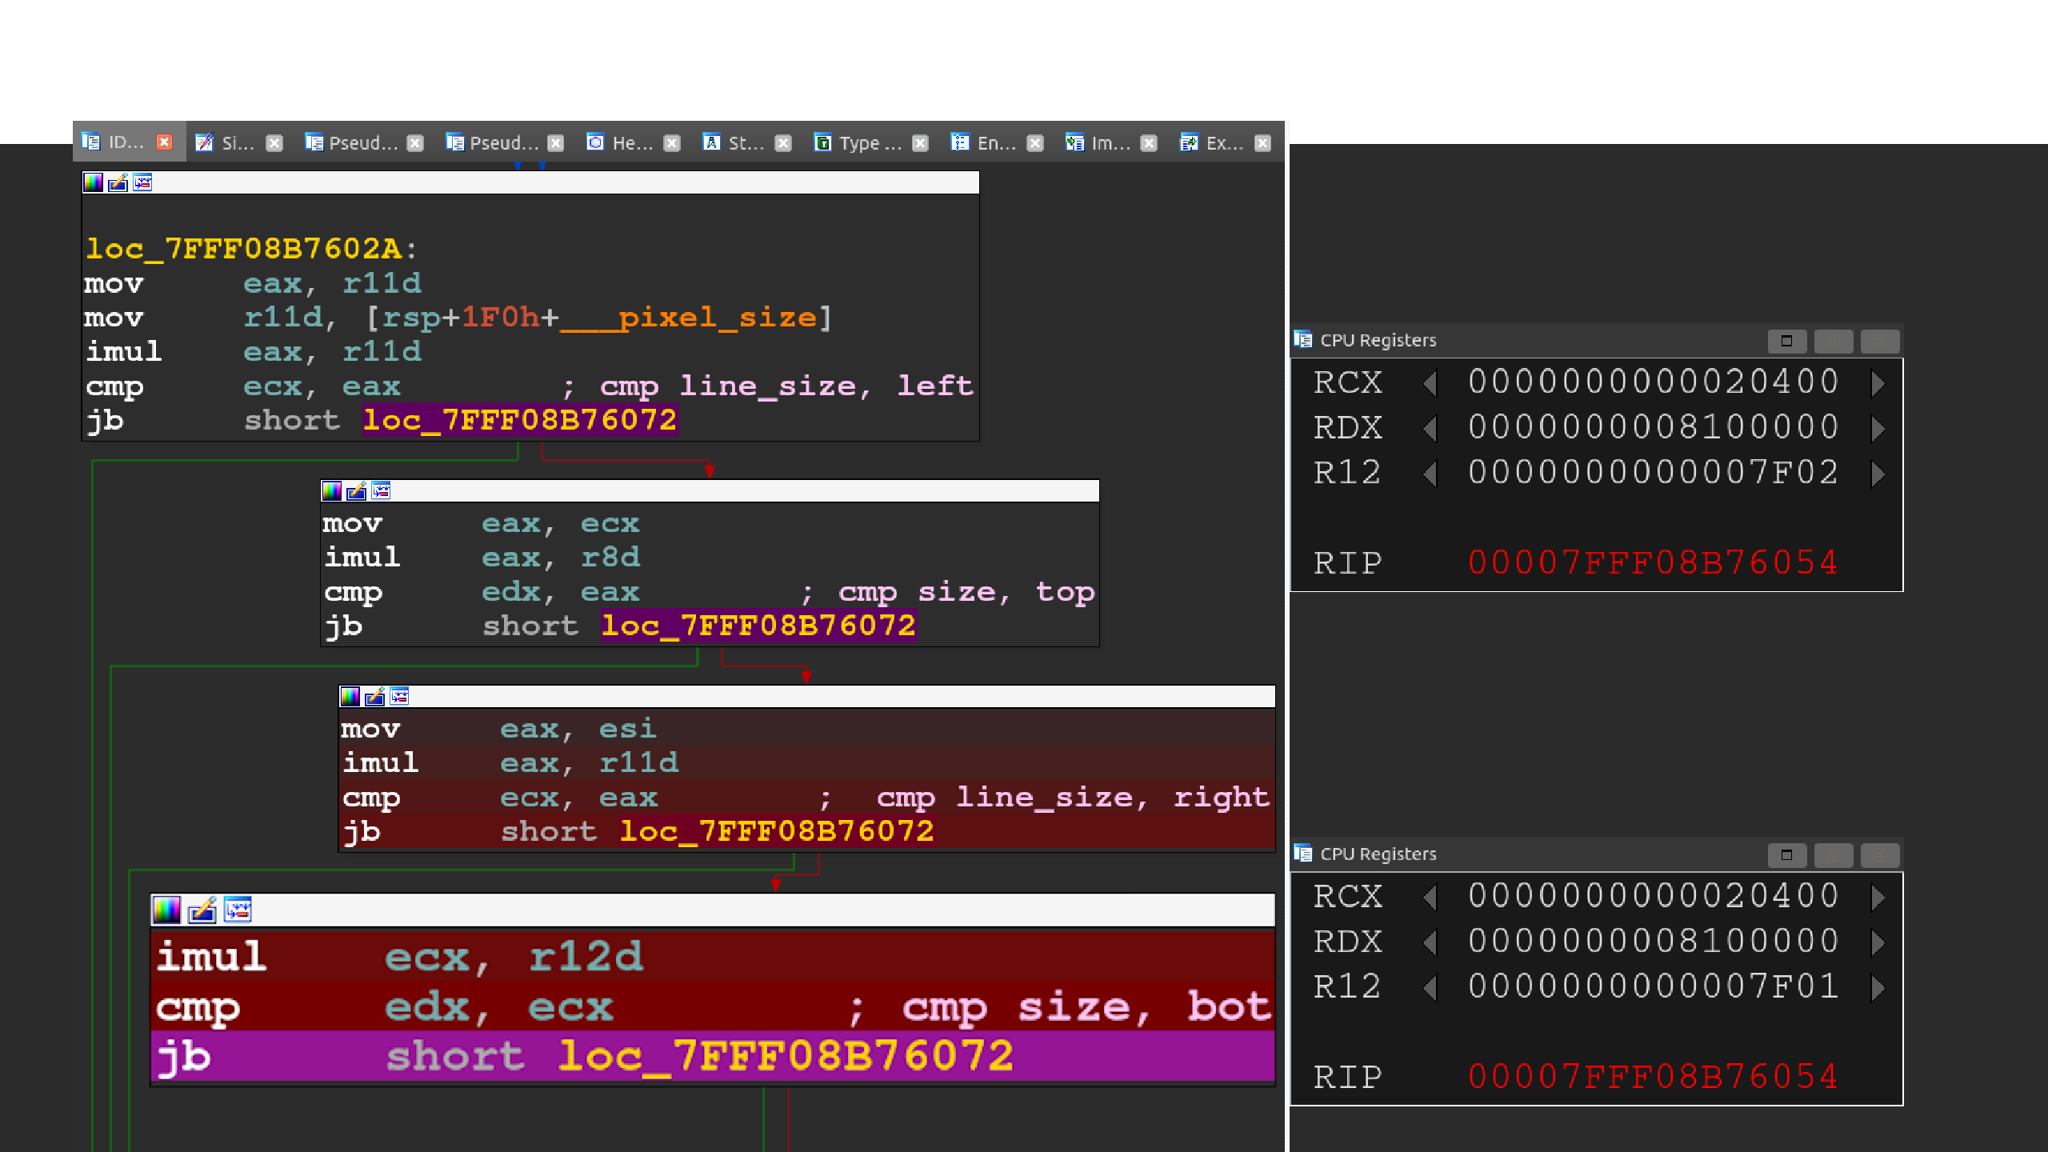
Root Cause Analysis with Tenet
Crash
skip branch
No crash
take branch

Slide 47
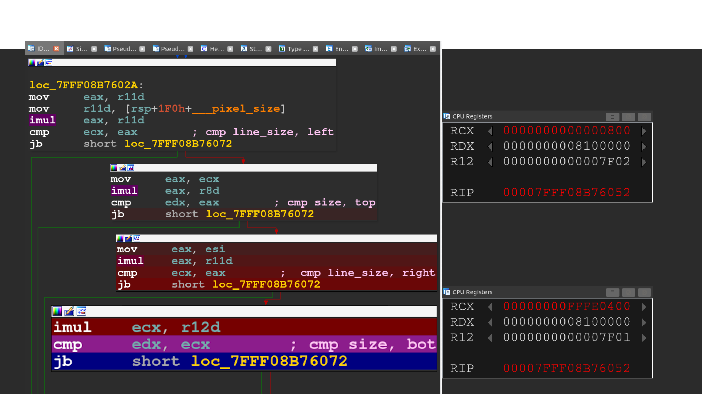
Root Cause Analysis
Crash
edx
> 0x800
No crash
edx
< 0xFFFE400

Slide 48
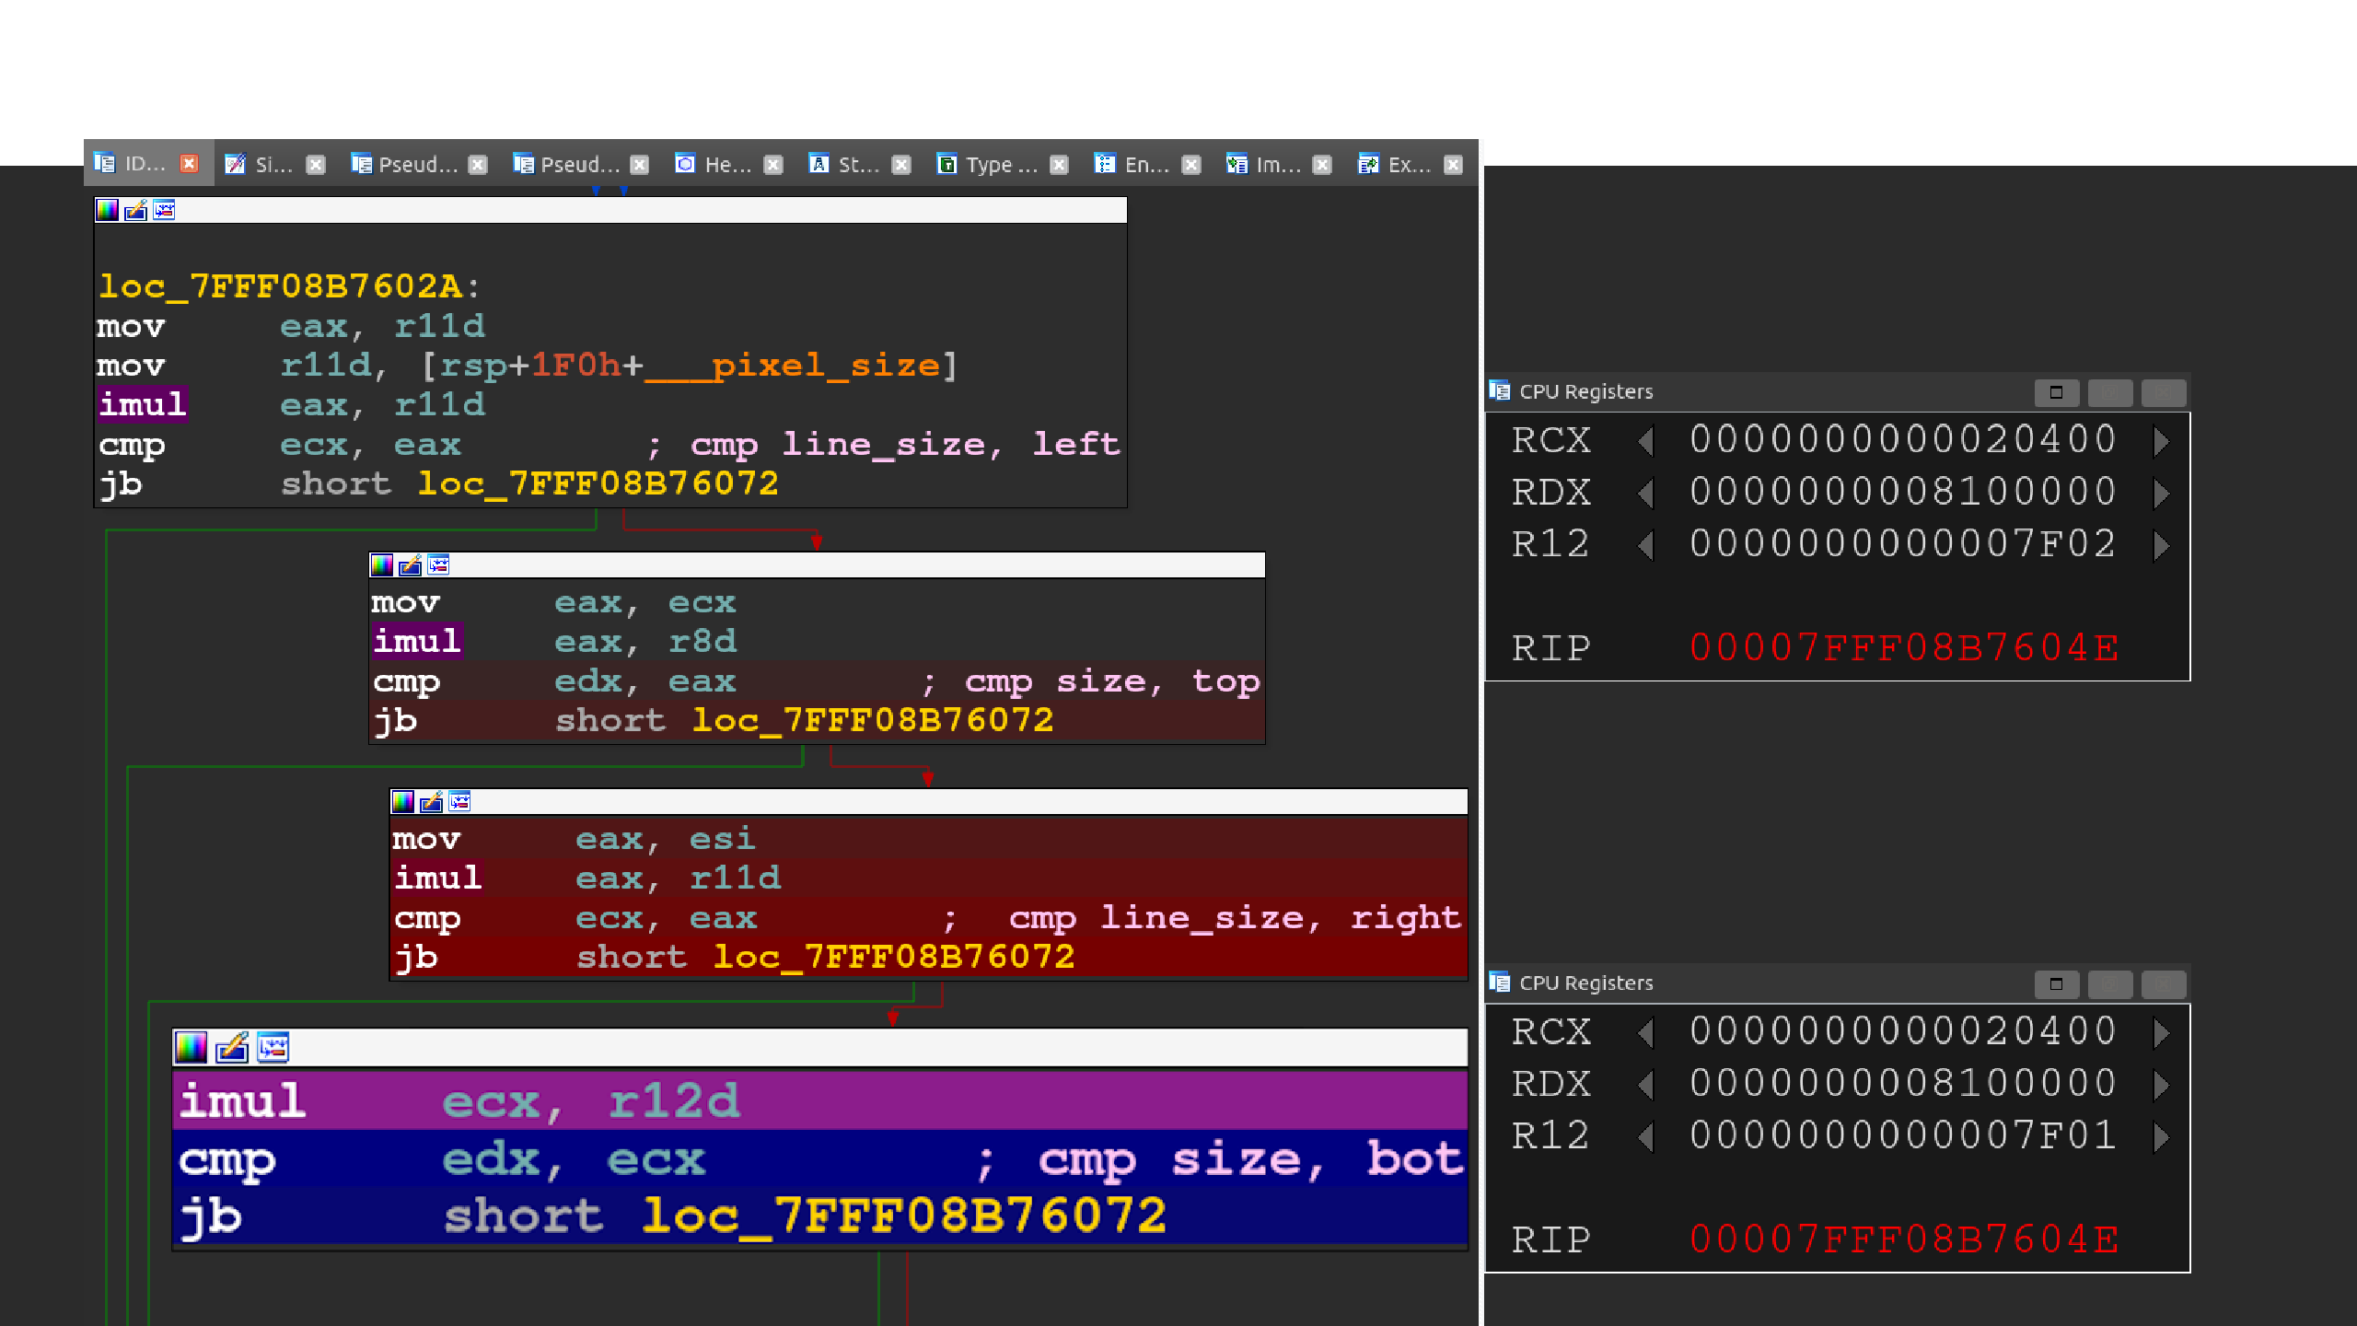
Root Cause Analysis
Crash
R12
= 0x7f02
No crash
R12
= 0x7f01

Slide 49








Crash Analysis - Recap
Unvalidated crash with huge trace
Seems legitimate after reading specification crash trace minimization
oobw in d3d10warp.dll Repro. without HW 3D root cause identification with diff
root cause analysis with Tenet by @gaasedelen
integer overflow in
UMContext::CopyImmediateData

Slide 50








Impact

Slide 51



Impact
CREATE_SURFACE

Slide 52



Impact
CREATE_SURFACE
SOLID_FILL 0xFF . . . . . .

Slide 53

PoVuln: Malicious FreeRDP Server
Dockerfile
FreeRDP Patch
CREATE_SURFACE
SOLID_FILL
> 4Gb
0xFF . . . . . .
Several constraints
No exploit, just a crash
< 256kb
5 3

Slide 54
Responsible disclosure
Patch Tuesday
CVE-2022-30221
HexaCon talk
request
Bounty review
Bug confirmed
$5000 awarded
Released Pre-release Repro
New
March
April
May
June
July
5 4

Slide 55
Conclusion
OOB write in d3d10warp
triggerable remotely through RDPEGFX
On the fly modification of fuzzing data
Exotic coverage
Trace minimization
wtf, diff, and tenet
MS Open Spec. Program MS Win. Protocol Test
Suites
more on thalium.re
5 5

Slide 56
d3d10warp.dll Broader Impact?
without hardware acceleration, loaded by: explorer.exe
msedge.exe and msedgewebview2.exe
winword.exe and other MS Office executables
...
with hardware acceleration, loaded by: explorer.exe and a few others
Anyway: CVE- 2022 - 30221 f ixed in July -- No exploit
5 6

Slide 57





Fuzzing RDPEGFX with what the fuzz
Questions?

